Slide 1

Navigating the Data Jungle
Copilot, Process Mining, and Power Automate Adventures!

Slide 2
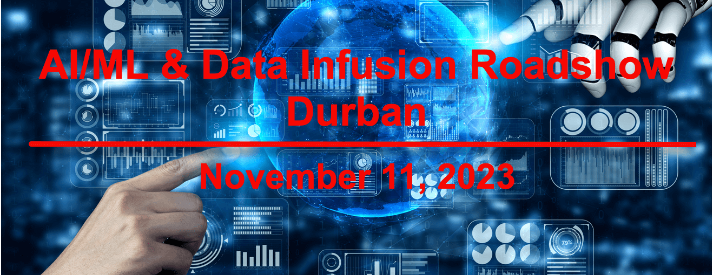
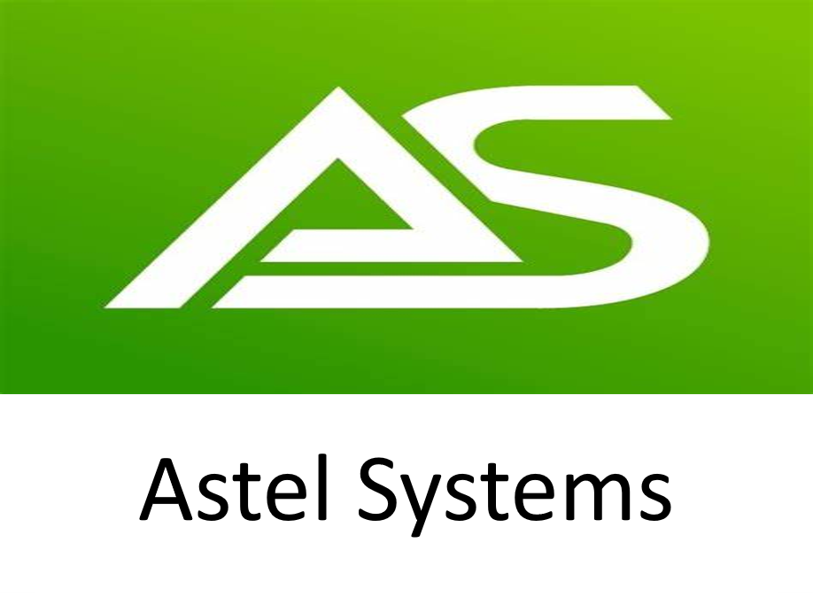







Thank you to our SPONSORS

Slide 3
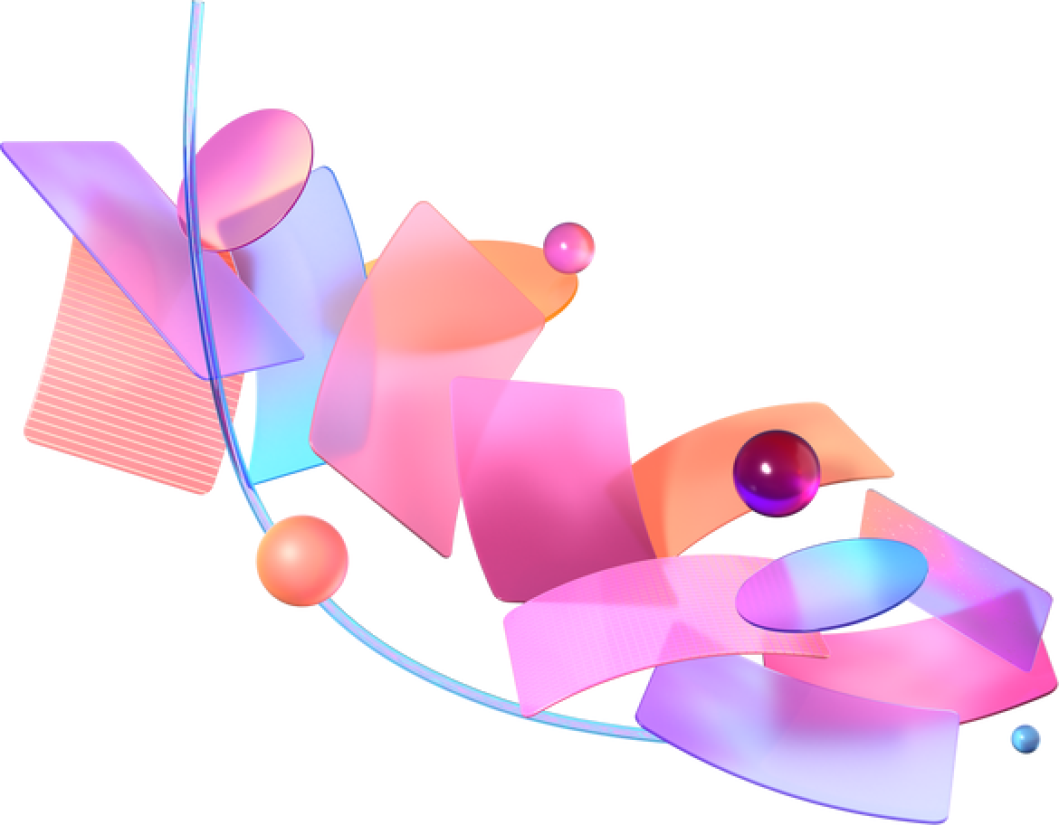






Who am I?
Carike Botha (@Carike_B)
Software Developer

Slide 4
AI Capability in Power Automate
Copilot
You can create a flow by describing what you need through multiple steps of conversation.
Process Mining
Process mining is a research area and technology that helps businesses understand their real processes, how they're operated, and identify opportunities for improvement, automation, and digitization.
AI Builder
Create intelligent automation and find insights by building tailored AI models within Power Automate.
Azure Open AI
Enhance automation capabilities using advanced AI models, including GPT, with Azure OpenAI Service.

Slide 5



Let’s PLAY
Demo Time!

Slide 6
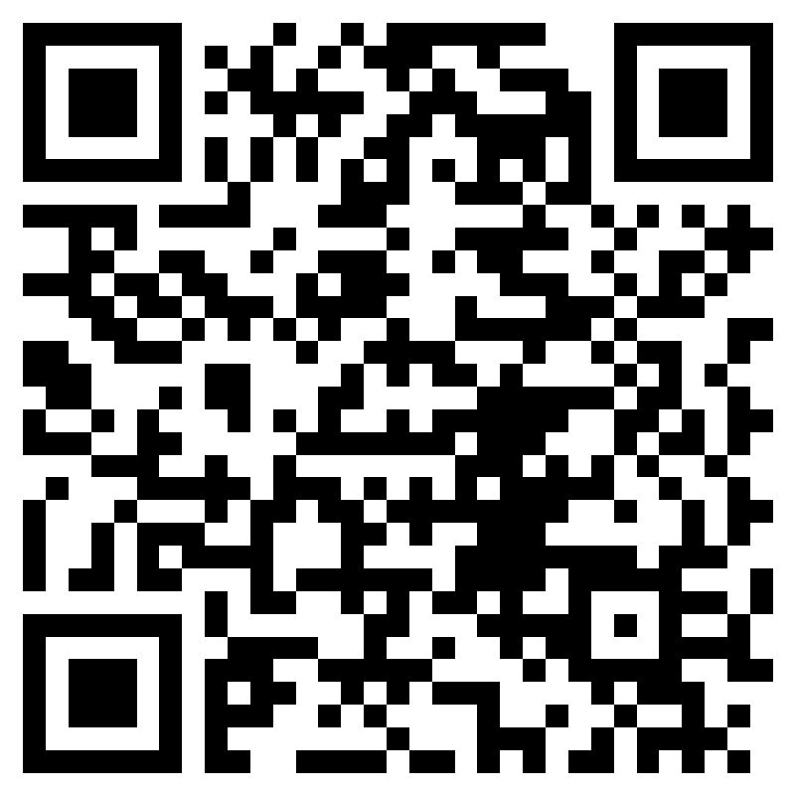

Don't forget
SESSION EVALUATION
Please evaluate the session!
Enter your name on the evaluation form to stand a chance to win awesome prices!
URL: https://forms.office.com/r/S4q6TUDkua

Slide 7

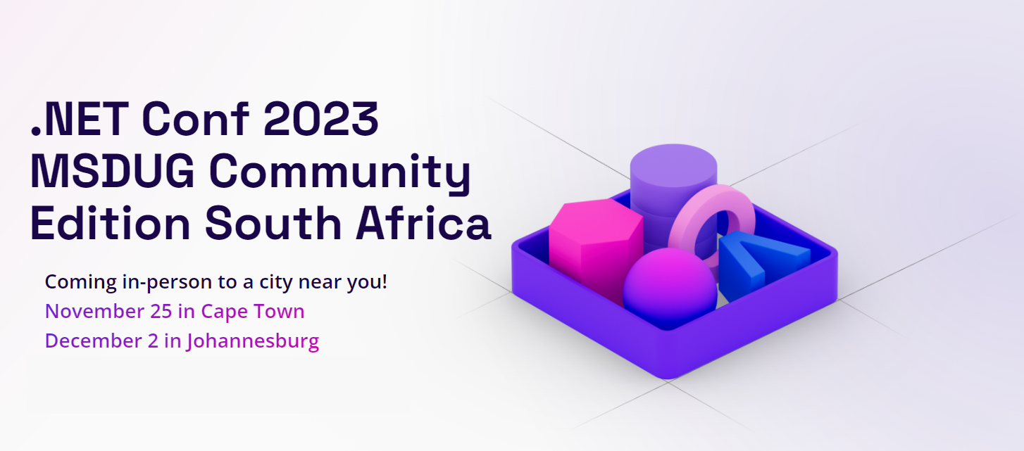

.NET Conf MSDUG Community South Africa 2023
2 Tracks in each city
18 Speakers
Tickets: Johannesburg https://aka.ms/dotnetconfsa-jhb
Tickets: Cape Town https://aka.ms/dotnetconfsa-cpt
Website: https://cptmsdug.dev

